Slide 1
Weekly AOI Transfer team
Hyeongju Choi, Ritika Gupta, Jasmine Hawkins, Sharon Heung, YoonBo Shim

Slide 2

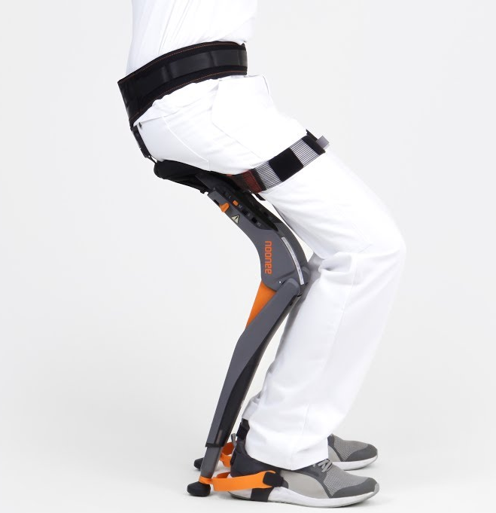
Accomplishments
Completed safety training at the CoMotion Makerspace
Had our weekly meetings on Friday:
Compiled a list of interview questions + ideas
Researched existing ideas + shared them
Problem Statement: Carolee needs to safely transfer from standing to sitting in a way that makes her feel independent and empowered
Things to consider: affordability, adaptability, compactness
Got in touch with Carolee to schedule an interview

Slide 3
Objectives
Issues
Actually meet with Carolee! Hopefully the 24th!
Finalize our questions/game plan of the interview
Hopefully the interview will give us new insight and more direction!
none this week!

